Slide 1

WAY TO ENTERPRISE
AWS
VTI ACADEMY
Author: duy.nguyenngoc1@vti.com.vn

Slide 2
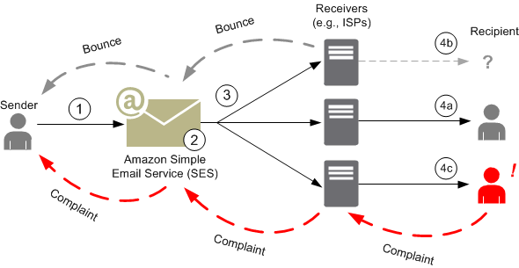
Simple Email Service
A email service that allows developers to send & receive email using email addresses, domains
Ex: Sending marketing emails (special offers), transactional emails (order confirmations), other types of correspondence (newsletters), ...
Cost-effective, flexible, scalable
Serverless Service
Price: https://aws.amazon.com/ses/pricing
Tutorial: https://docs.aws.amazon.com/ses/latest/dg/Welcome.html

Slide 3
Simple Email Service
Demo
  https://www.youtube.com/watch?v=0HeOrZ4sBGo
  https://youtu.be/gVRTKuMFc0c?t=887
  https://www.youtube.com/watch?v=nxXIpPZzMd0

Slide 4
Q & A
Copyright © VTI Academy All Rights Reserved

